Slide 1

UHCL Communicator
Presented By:
Instructor: Soma Datta Ridhima Joshi
Nagarajan
Sudheera Dama
Mounika

Slide 2
Presentation Outline
Introduction
Analysis and solution
Process model
UML Use case diagram
UML class diagram
UML sequence diagram
Architectural design
Screenshots
Summary
References

Slide 3
Introduction
The instructions needed by freshman when they join a college.
* Accommodation
* Course information
* Culture of college
* Food
* Climate of the place
* Things to pack/not pack
Whom do they consult?
-The current students and the alumni.

Slide 4
Analysis and solution
UHCL Communicator android app helps the freshman students.
We have included the option of discussion board.
Post a query through the app
Reply to a query or get reply to a post you made.
Get the details of the student or alumni like their names and mail ids.
It can act as a communication channel between the students.

Slide 5
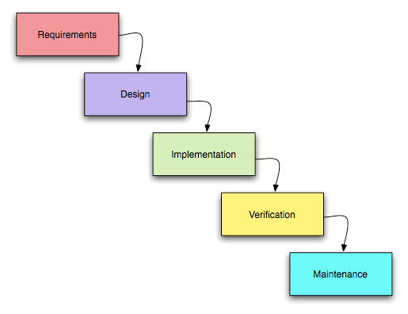
Process Model
Waterfall model
- Requirements: use cases
- Design: UML Diagrams
- Implementation: Coding
- Verification: Usability Testing
- Maintenance: Issues after deployment

Slide 6
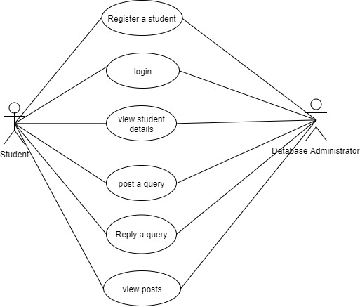
UML Use case diagram

Slide 7
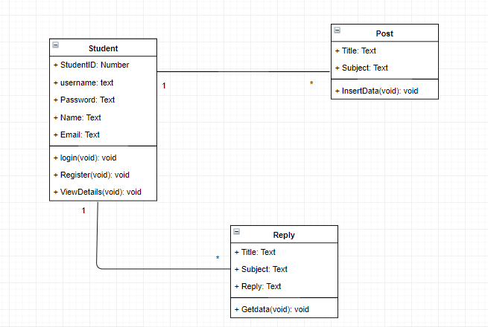
UML class diagram

Slide 8
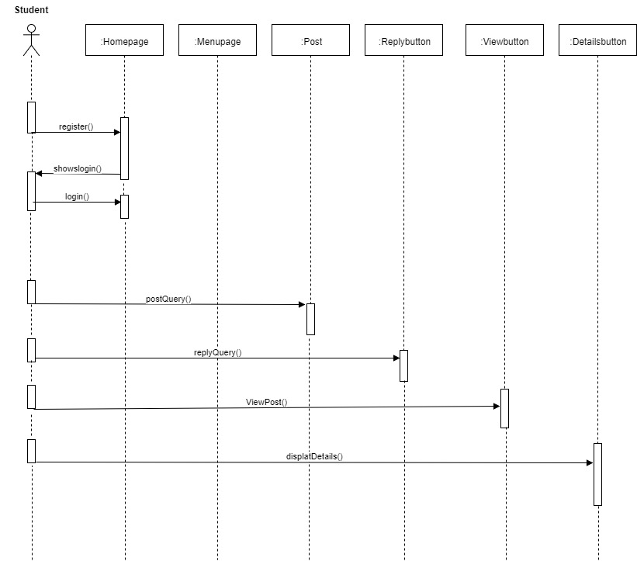
UML sequence diagram

Slide 9
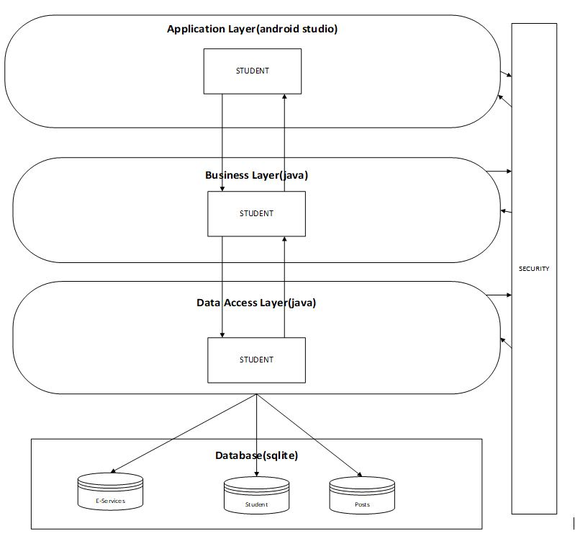
Architectural design

Slide 10
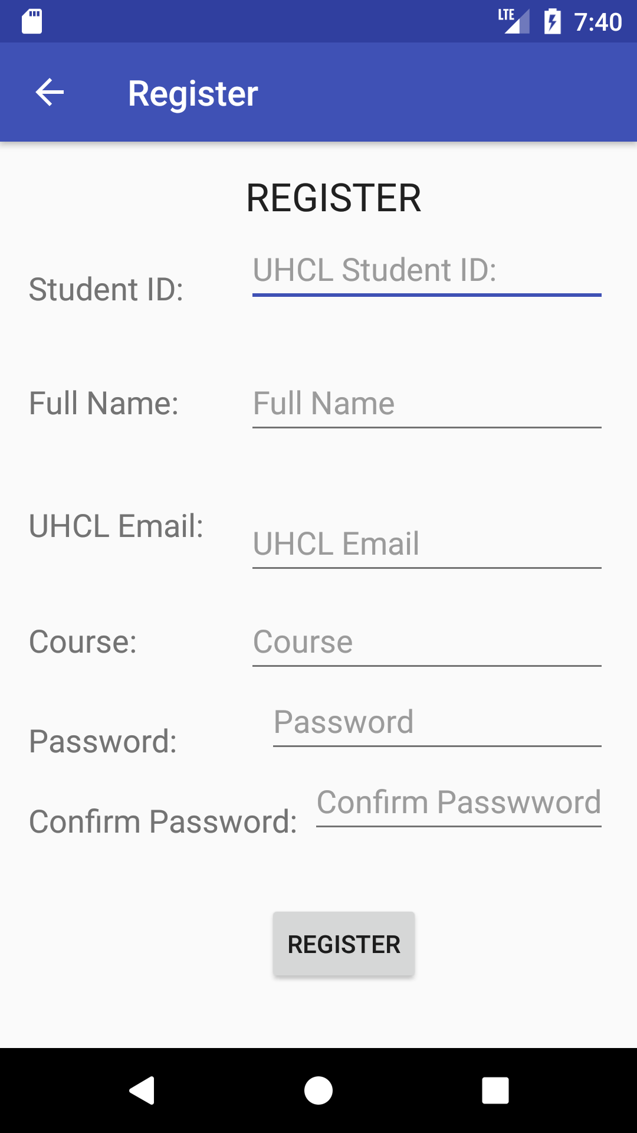
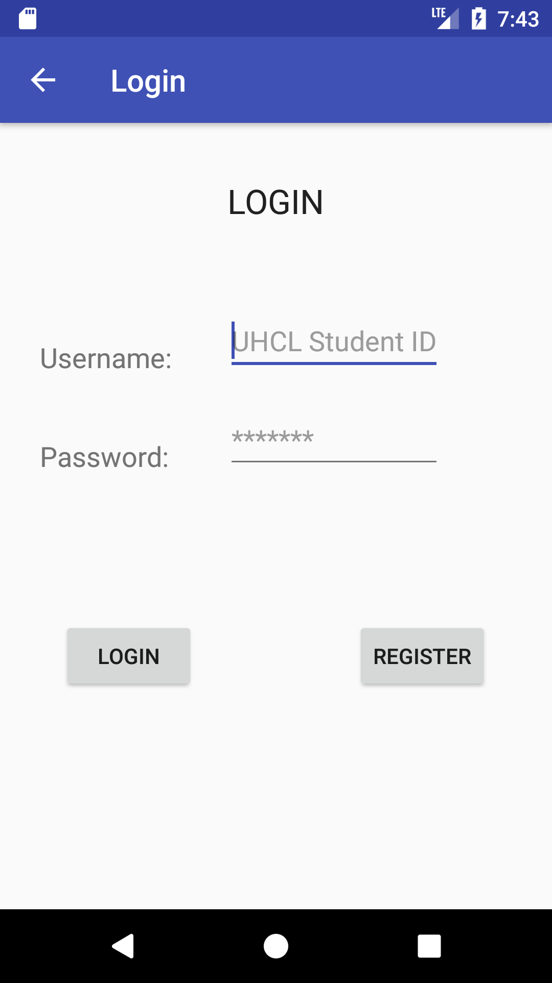
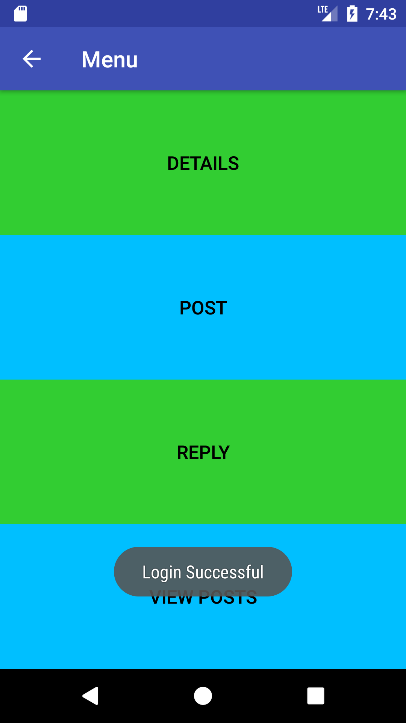
Screenshots

Slide 11
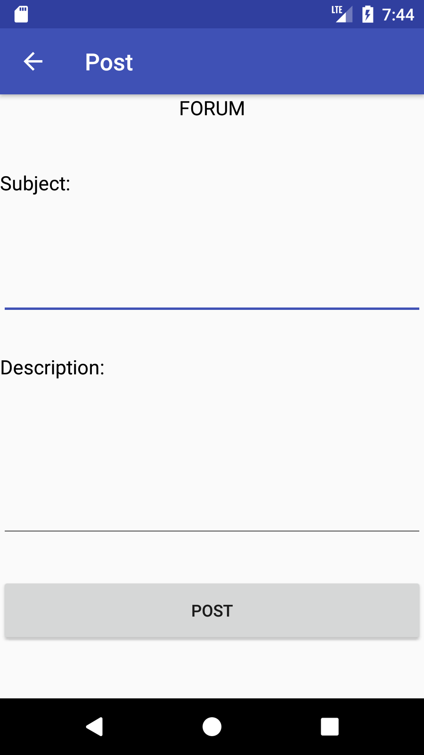
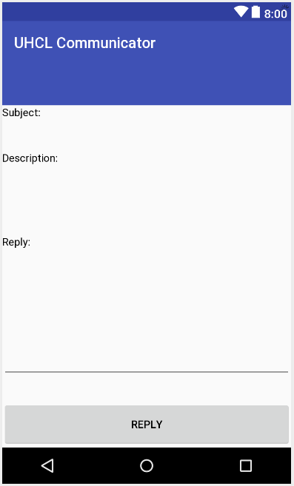
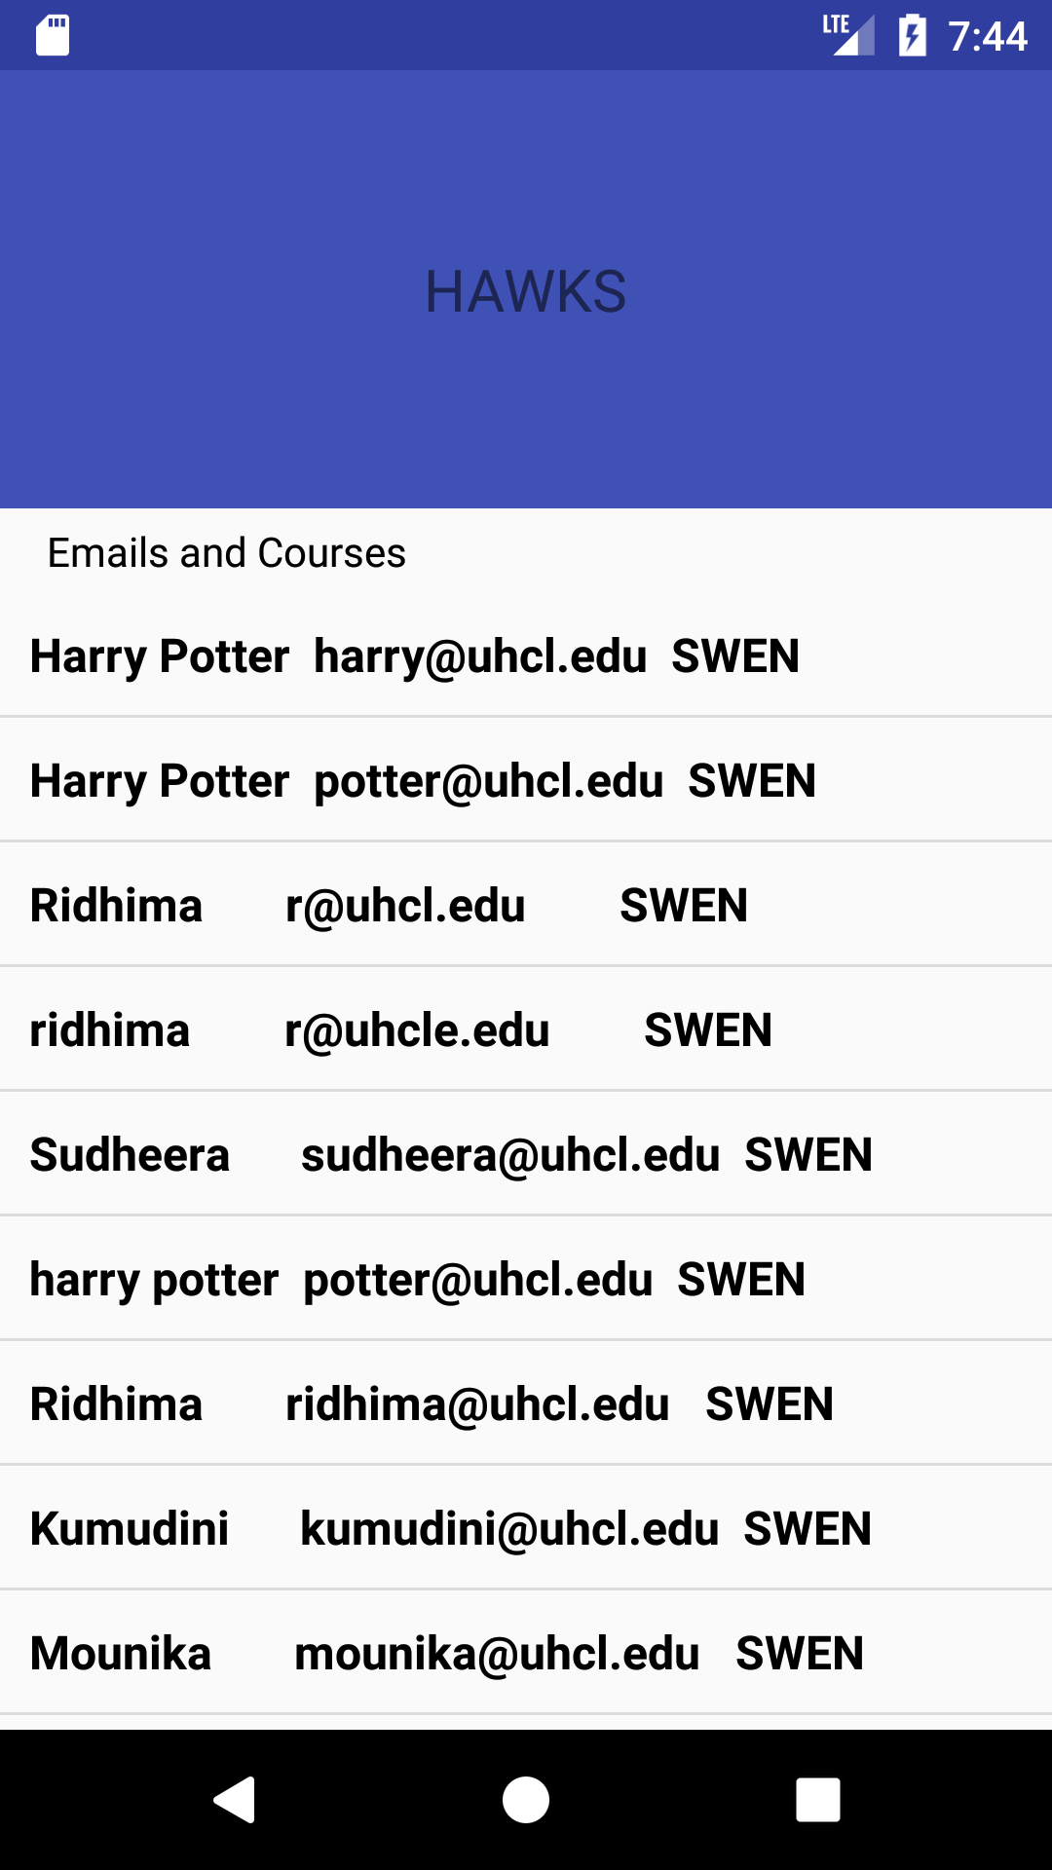
Contd..

Slide 12
Summary
UHCL Communicator is a application which helps in freshman students in getting timely help.
By using this application:
Freshman can get details of the alumni or senior students.
Students can post a question related to anything just by mentioning it in the subject.
Students can get a reply from the seniors or alumni.

Slide 13
References
https://en.wikipedia.org/wiki/Waterfall_model
https://developer.android.com/studio/command-line/sqlite3.html
https://developer.android.com/reference/classes.html

